Slide 1
Internal Audit Insights
September 2024

Slide 2
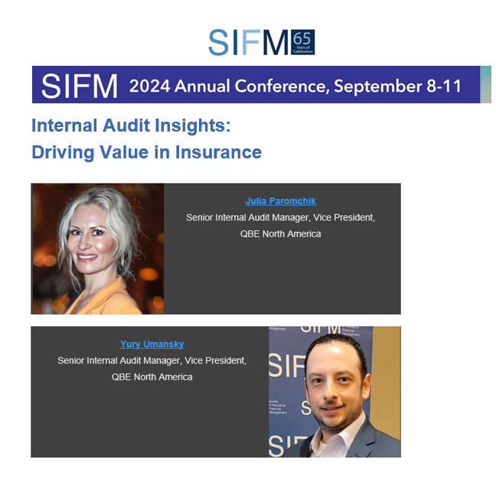

Slide 3
Integrated Assurance

Slide 4
Integrated Assurance Overview
Overview
Integrated Assurance is the framework which enables the Company to maximise the coverage of assurance in a coordinated manner by targeting material exposures and minimising duplication or gaps across control functions.
It is a strategic management tool that facilitates decision-making relating to the coordination and integration of assurance work, optimising risk coverage, ensuring the right balance of assurance, and providing meaningful reporting to management and the Board.
Expected Benefits
Better visibility / stronger assurance focus re: key areas of risk
Improved insight through collective reporting
Opportunity to work more efficiently and reduce duplication across the 3LOD - Integrated Assurance Map

Slide 5
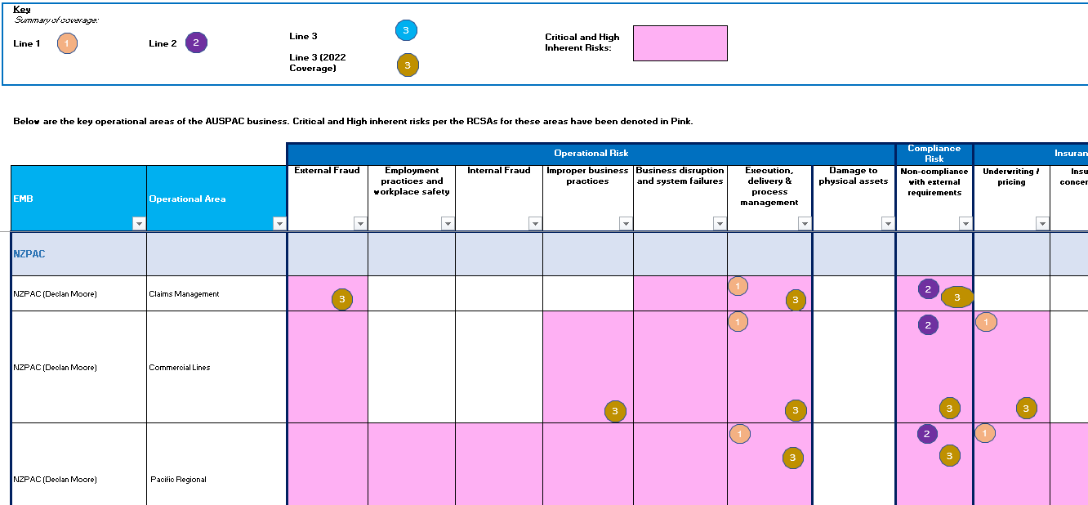
Integrated Assurance Map Example
Overlay assurance activities onto critical and high inherent risks
By organisation structure and risk class
Enables identification of gaps/overlaps in coverage with aim of targeting optimal assurance coverage

Slide 6
Integrated Assurance Map – Claims Organization Example
Assurance Calendar 2024 Claims Organization
Review name | January | February | March | April | May | June | July | August | September | October | November | December
1st Line BAU Assurance Activities
Claims Quality Assurance
Claims Compliance
Model Audit Rule (MAR) Control Assessment | 2023 MAR Testing |  |  |  |  |  |  |  |  | 2024 MAR Testing
Multi-Disciplinary Audits (MDAs) | Dependent upon TPA coverage
1st Line BAU RCSA Schedule
Claims Operations
Technical Claims
A&H Claims
Legacy Business Unit
Aviation Claims
Financial Lines Claims
TPA Management and WC Claims
Risk Solutions
2nd Line Compliance Assurance
None currently planned
2nd Line Risk Assurance
None currently planned
Group Internal Audit
In House Claims (Financial Lines)
In House Claims (Property)

Slide 7
Integrated Assurance – Realized Benefits
Realized Benefits
Expected Benefit: Helps avoid duplicative assurance and therefore promotes efficiency
Outcome: through Integrated assurance map, reduction of audit scope and/or extent of testing in consideration for ongoing Quality Assurance reviews and results (e.g., Management Liability Underwriting (2024); Aviation Claims (2023); Delegated Underwriting – Commercial & Specialty (2023))
Expected Benefit: Can provide awareness of and reduce any potential assurance coverage gaps on key risks
Outcome: identification of areas of reduced risk coverage across various assurance functions (e.g., Talent and People)
Expected Benefit: Boosts collaboration, communication and promotes ability to adapt assurance focuses during a year and/or within an audit.
Outcome: more targeted focus through enhanced understanding of risk environment and key focus areas based on participation in the ERM & Compliance Roundtable discussions, attendance of the quarterly Underwriting Excellence Forums, review of the Multi-Disciplinary Audit reports, involvement of Line 1 Risk and Line 2 liaison(s) and Model Audit Rule (MAR) team during all phases of an audit (e.g., Management Liability Underwriting; Shadow IT)

Slide 8
Integrated Assurance – Commercial Casualty Review Example
Objective
Observations and Recommendations
Portfolio Monitoring: Current portfolio monitoring routines are not automated and require manual data capture protocols performed by the underwriting team to track key performance indicators. A process will need to be created that uses source system data to build a dashboard for managing all key performance metrics and thereby eliminate manual monitoring.
Pricing Model Development: The Day 1 pricing model currently used on all relevant accounts by the underwriting team was deemed not fit for purpose and was subsequently retired. A new pricing tool has been developed by the pricing actuaries.
Appetite Refinement: To enable the business to better carve out and write the more desirable aspects of certain classes of business, the risk appetite will need to be further refined through the build out of the Appetite Guide. A process should also be established for the continuous monitoring and refinement of the risk appetite.
Policy Administration: The Policy administration system is currently utilized as booking only. The policy issuance process is manual. The identification of a sustainable and controlled means for policy issuance will be required to accommodate portfolio growth.
Evaluate Commercial Casualty’s readiness to profitably meet their growth ambitions and targets;
Furnish an objective opinion on the operational structure in place to facilitate team’s success;
Provide recommendations to assist in the establishment of a sound control framework.

Slide 9
Future Options
Incremental value
Coordinated annual planning process, supported by the Integrated Assurance mapping exercise to map proposed assurance activities against key risk exposures.
Evolved version of integrated planning:
More sophisticated approach which recognises that the nature and quality of assurance across the 3 Lines varies. Understanding of, and allowance made for differences in scope/focus, methodology, rigour, skillset and independence between assurance providers.
Potential reliance model
Execution of joint audits / reviews
Integrated reporting and insights:
Coverage map becomes outcomes map
Thematic reporting

Slide 10
Generative AI Use Cases

Slide 11
Governance & Security
Groupwide AI governance Framework.
NAO specific Governance & Oversight Committee with broad cross-functional representation.
Establishment of a dedicated on-prem version of ChatGPT – “Q-GPT”.

Slide 12
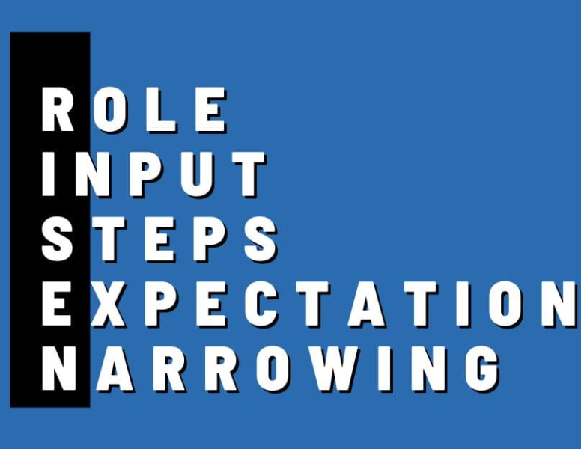
Prompt Engineering
Role: This is about understanding who is involved. In ChatGPT, it's often the AI itself. What role does it play? Is it an advisor, a creator, or a problem-solver?
Input: This is the data or information you provide. It's like telling a story to the AI. The input can vary - a question, a statement, or even a set of data points.
Steps: These are the instructions or directions you give. It's like a recipe for the AI to follow. The clearer and more structured your steps, the better the outcome.
Expectation: What do you want at the end? It's the goal or the outcome you're aiming for with your prompt. Clear expectations lead to more targeted and useful AI responses.
Narrowing: Please provide any restrictions, limits, or what to focus on for the AI to follow, like limits on word count or particular areas to focus on.

Slide 13
Generative AI Use Cases – Internal Audit
Executive Summary &
Report Drafting
Problem: Development of an Executive Summary for an audit report is an often a time consuming and complex process, subject to varying report writing styles, and can be challenging to balance for the intended audience.
Solution: Leverage LLM AI tools into the review process to enhance the quality and efficiency of executive summary writing within Internal Audit reports by utilizing ChatGPT's language analysis capabilities.
Benefit:
Improved and standardized quality of executive summaries, aligned with report writing guidelines.
Time Savings during Reporting phase of audit.
Improved Executive summaries that are contextually complete, succinct and appropriate for the readers.
Prompt Components
Role: Experienced Internal Auditor and Insurance Industry Specialist.
Input: Tasked with evaluating executive summaries within internal audit reports for the board audit committee, ensuring they adhere to established report writing guidelines (provided with prompt).
Steps:
Review the executive summary against the provided guidelines; identify deviations and suggest specific revisions.
Analyze for completeness, ensuring all critical report aspects are covered and no context is missing.
Evaluate succinctness without losing clarity or completeness; condense unnecessarily lengthy sections.
Anticipate potential questions the reader may have; suggest improvements to address any gaps.
Expectation: Provide detailed, actionable feedback in a Word document, helping streamline the revision process and improve the quality of summaries. Consider clarity, adherence to guidelines, and reader engagement. Point out exemplary areas and gaps in the writing and recommend areas for improvement where clarity or completeness may be lacking.
Narrowing: N/A

Slide 14
Generative AI Use Cases – Internal Audit
RCM
&
Audit Work Program Evaluation
Problem:
The preparation and review of the Risk and Control Matrix (RACM) is a highly manual process and prone to varying quality, errors and can be time intensive process. Ensuring adherence to internal quality standards and industry best practices is critical to ensure applicable risks and controls are covered and the engagement is completed within the established timeline and budget.
Solution:
Leverage LLM AI tools (e.g. ChatGPT) into review process through 1) Automating initial review of RACM’s to identify potential gaps in risk identification and applicability of identified mitigating controls and 2)Standardize risk and control descriptions by comparing them against control wording guidelines/standards.
Benefit:
Improvements in quality of risk/control descriptions and consistencies of RACM.
Time Savings during planning with RACM design.
Scalable and easily repeatable process across all of GIA.
Prompt Components
Role: Experienced Internal Auditor and Insurance Industry Specialist.
Input: You will be comparing the Risk and Control Matrix (RACM) with the risk register for the (insert function name) business unit. Your objective is to identify unrecorded risks, discrepancies, or gaps.
Steps:
Review the completeness and relevance of identified risks for the respective business unit.
Evaluate controls to ensure they effectively mitigate the associated risks and highlight any inadequate ones.
Assess the clarity and specificity of control wording, ensuring alignment with internal control standards (provided with prompt), and provide recommendations for improvement.
Identify gaps where additional risks or controls are needed and propose new or modified risks and controls if necessary.
Evaluate whether the included test steps are in alignment with the noted risks and controls and highlight and test steps that don’t appear applicable, sufficient, or relevant. Suggest alternative testing approaches, if warranted based on initial evaluation.
Expectation: Summarize your findings into an actionable Excel document, detailing exemplary areas, gaps in risk coverage, and any ineffective or poorly documented controls. Provide a detailed and actionable analysis, ensuring clear explanations for each point of feedback. Highlight areas that may require further investigation, such as vague control wording or missing risks, and ensure the findings can be directly implemented to strengthen the Risk and Control Matrix (RACM).
Narrowing: N/A

Slide 15
Generative AI Use Cases - Business
↑ Link to Article ↑ ^
“Our approach to technical innovation is driven by our commitment to enhance efficiency, accuracy and the customer experience through the strategic adoption of advanced technologies, particularly generative AI.”
- Vinay Kurup
Cyber Submissions AI assistant
Problem:
Before automation, evaluating each Cyber Policy submission generally took 2+ hours, which was a challenge given submission volume and available resources. This ultimately impacted the ability to grow the LoB while ensuring quality UW.
Solution:
Creation of a tool which automates the initial stages of the cyber insurance submission process, providing our underwriters with detailed risk assessments and streamlined workflows. The tool offers a centralized portal that prioritizes submissions, provides initial assessments, critical data points, and associated risks, resulting in a higher conversion ratio compared to prior year.
Benefit:
Reduced review time, leading to high submission review/response rates and timelines.
Time Savings during planning.
Scalable and easily repeatable process across the audit team(s).
Future Focus:
Extend these capabilities to other QBE divisions in Europe and Asia, specifically for our Cyber business, demonstrating the scalability and adaptability of our solutions.
Adapting the automated submission process for other product lines, such as Workers’ Compensation in Asia, using the same effective methodologies from our Cyber product line.

Slide 16
Generative AI Use Cases – Next Steps

Slide 17
Risk Culture Assessment

Slide 18
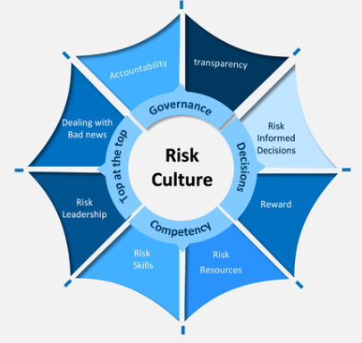
Risk Process vs. Risk Culture
According to the Bloomberg research, there are four pillars of Risk Culture:
Transparency – everyone contributes relevant information to inform the decision-making.
Challenge – ability of people not directly involved into the decision-making to question what is going on.
Humility – management willing to listen to dissenting voices and, if necessary, reverse their positions.
Curiosity – going extra mile to figure out what is going on.

Slide 19
How Risk Culture is monitored and assessed across the 3LODs
Governance committees
Agree and set the direction for the organisation’s desired risk culture and provides oversight over its implementation
Line 1: Business
Engage with training to uphold risk culture, and work with 2LoD to improve processes to manage risk culture
Line 2: Divisional and Group
Assess risk culture maturity and embed risk culture across the organisation
Line 3: Internal Audit
Assess how behaviours influence a strong or weak control environment, and identify and investigate cultural themes on broader risk issues

Slide 20
Considering the ‘soft’ controls
How to test and observe the ‘soft’ controls – Examples:
What are soft controls?
The intangible factors that influence and promote desired behaviours across an organisation to achieve its objectives.
Documentation review
Consider the tone and messaging of communication and reporting. For example, what is the balance between positive news vs. areas requiring improvement? How direct is the tone? Are the right things prioritised on meeting / committee agendas?
Consider trends / themes analysis. For example, staff turnover, engagement survey results, issue and incident data.
Interviews
What is the business’ level of awareness on the risk and control environment?
What is the business’ level of responsiveness towards known issues?
What is the business’ attitude towards the risks being raised by GIA?
How is the business responding to the questions or issues being raised by GIA?
What is the tone that has been set to the team by management (i.e. their leadership team, direct report, etc.)?
Observations
Working relationship within and between teams (e.g. siloed approach vs. clear cohesion).

Slide 21
Auditing Risk Culture – Assessment Criteria
Step 1: Define Risk Culture assessment strategy and approach
Step 2: Embed Risk Culture assessment approach
Step 3: Execute and monitor Risk Culture assessment approach

Slide 22
Auditing Risk Culture – Maturity Scale
9-10
7-8
5-6
Target state is consistently ingrained in the everyday behaviours and actions of leaders and employees across the enterprise. QBE may be known for maturity in this area. Continuous improvement is self-sustaining and evolves to meet business strategy.
3-4
Target state is broadly and consistently applied with mature systems, tools and processes to reinforce target state. Leaders and employees consistently applying target state behaviours and actions.
0-2
Consistent understanding of desired target state is in place with good reinforcing systems, tools and processes. Evidence that role modelling desired behaviours is occurring.
Some progress towards target state may be evident but this may be disparate, undefined, inconsistent or with clear gaps in pockets across the enterprise.
Largely absent or mis-aligned to the business needs.
Absent | Reactive | Managed | Embedded | Self-Sustaining
Target State Score = 8

Slide 23
Reporting: Example of Risk Culture Assessment
Risk Culture Dimension | Assessment Criteria | Scoring | Supporting Comments
RC5. Psychological Safety & Speaking Up Employees feel safe to speak up, are treated respectfully when they do so and have appropriate language for calling out risk, enabling them to give and receive constructive challenge and raise concerns and queries. | Consider the following types of evidence points: • Observe employees' behavior during the walkthrough and interactions with GIA/inquire in interviews about their comfort level to speak up. • Reviewing the most recent applicable results for Voice pulse survey questions such as: "In my team, we regularly discuss managing risk" and "In my team, we call out poor behaviors, issues and/or concerns. Request from People Function. • Did management openly share information requested? • Employees and management have proactively raised issues and incidents during the audit period. | Reactive (3) | 1. Through walkthroughs, staff members were not able to clearly articulate steps within underlying processes, nor did they display a reasonable understanding of the key risks and controls in place. Staff displayed instances of blame culture and defensiveness to simple queries from GIA during meetings and walkthroughs, which resulted in the Engagement Manager having to attend all meetings to facilitate. Through planning and fieldwork meetings, GIA observed that, while several issues and control deficiencies were known to management (such as repeated errors, robustness of reviewer sign-offs), breaches were not voluntarily reported via Insight. Management advised that this was due to unfamiliarity with the Insight system and compounded by staff reluctance to report breaches due to the fear of negative repercussions on individual performance/reward etc. 2. Recent Voice Survey results inspected indicate low scores in respect of Challenger Safety ('In my team, we have healthy debates where different opinions are encouraged') and 'Call It Out safety'. Management is aware but have no firm action plans to address this opportunity area.

Slide 24
Reporting: Example of Audit Issue on Risk Culture
Issue No. | Issue Description | Issue Rating | Management Action Plan | Issue and Action Owner / Due Date
ISS. 1 | GIA observed that staff and management were not able to articulate the key risks and controls relevant to their area and lack the sense of safety to effectively challenge and raise concerns or queries. These weaknesses have been identified through all recent (2023) Voice Survey results, but with no action plan to address. Furthermore, while several control deficiencies were known to management, these have not been voluntarily reported as incidents or near misses lodged on Insight. Management have advised that there is a reluctance by staff to report breaches due to fear of repercussions. Methods of addressing this are being discussed with the Risk team. [RMS: Operational Risk – Execution, delivery, and process management]. | Medium | Management will undertake a deep dive review of in-scope processes, as part of the forthcoming Risk and Control Self-Assessment (RCSA), involving all team members. Management will conduct training on both the Insight system, and breach definition, identification, and handling with a view to influencing positive risk culture. | Issue Owner: Due Date: Action Owner: Due Date:

Slide 25
Reporting: Example of Executive Summary Extract
Executive Summary extract:
We assessed the risk culture of the Policy Administration team using the QBE Risk Culture Framework. Our audit identified that, for five out of six risk dimensions, the function demonstrated ‘Managed’ or higher scores, with only one area of weakness against the Risk Dimension of ‘Psychological Safety & Speaking Up’ (RC5). The remaining five risk dimensions of risk culture were assessed to be at least ‘Managed’ against the Framework, demonstrating a consistently application of risk culture attributes. An audit issue was raised, linked to inadequate self-reporting of errors – see ISS.1.

Slide 26
Reporting: Thematic Dashboard – Example
Risk Culture Target State | Specialty –Consolidated | Motor | Aviation | Marine | Construction | Health Care
Risk Culture Target State | Maturity Rating | Maturity Rating | Maturity Rating | Maturity Rating | Maturity Rating | Maturity Rating
Overall Maturity Rating
1. Risk Governance
2. Tone from the top and people leaders
3. Risk Appetite & Risk based decision making
4. Risk Skills, Resourcing and Capability
5. Psychological safety and speaking up
6. Performance Management & Incentives
A | R | M | E | SS
A | R | M | E | SS
A | R | M | E | SS
A | R | M | E | SS
A | R | M | E | SS
A | R | M | E | SS
7.3
7.5
7.5
6.8
6.7
7.3
6.9
7.2
7.8
7
7.2
6.7
7.6
8
8
7
7
8
7
8
8.4
7
8
6
7.8
8
8
8
7
8
6.6
6.8
7.6
8
7
6
7.0
7
7
6
7
7
6.2
6.7
7
6
6
6
6.7
7
7
6
6
6
6.8
7.3
7.6
6
7
6
7.0
7
8
7
6
7
7.4
6.8
8
8
8
8
7.4
8
7
7
7
8
7.2
7.4
8
7
7
8

Slide 27
Risk Culture Assessment – Benefits
Management and the Audit Committee can gain valuable insights into the organization's risk management practices, leading to better governance, more effective risk mitigation, and ultimately, greater organizational success.
Enhanced Risk Awareness: evaluation of level of embeddedness within organization.
Increased Accountability: identification of areas where risk ownership might be unclear or inadequately managed.
Continuous Improvement: identification of opportunities to enhance the culture of learning and innovation across the organization.
Leadership Influence: assessment of the tone at the top and its effectiveness in promoting positive role modeling.

